Slide 1
Adolescent Journey
Shumita Littlefield

Slide 2
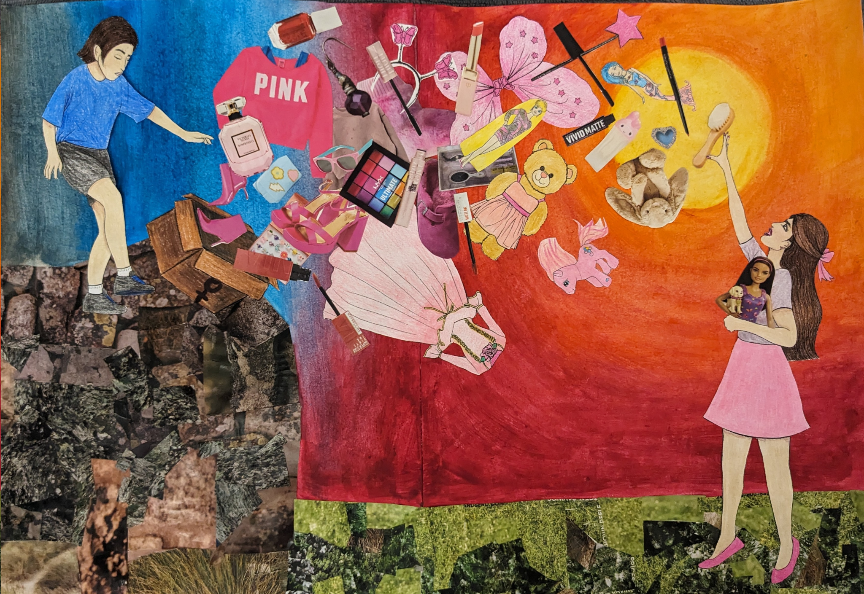
Adolescent Timeline
I used to be really shy, and so I thought about when I really started to change
High school, sophomore year, Creative Writing Club
I found people with similar interests and senses of humor, made lots of friends
Slowly I became happier and more outgoing
I later realized that this pattern of social anxiety matched the pattern of my interests
I became more open with others about my real interests
Notes:
Lot of trouble with this assignment at first because it’s hard to pinpoint becoming an adolescent,
I used to be really shy, and so I thought about when I really started to change
High school, sophomore year, Creative Writing Club
In the club I made new friends and saw good role models
Slowly I became happier and more outgoing
I later realized that this pattern of overcoming my social awkwardness and anxiety matched the pattern of my interests
When I am myself and show my love for things I’m really passionate about, that is when I am the most happy.

Slide 3
What changed?
Accepting my own interests was part of my personal journey.
As a kid, I loved all things pink, sparkly, and ‘girly’, but later find out that those interests are weak
I put on a fake tomboy persona and hid my femininity more
The social perceptions of femininity means that people do not
Notes:
I realized that I could not force myself to be somebody I am simply not. Accepting my own ‘girly’ interests was part of my personal journey.
As a kid, I loved all things pink, sparkly, and ‘girly’. But I soon learned that feminine things/things associated with girls or women are bad, or weak, or even shallow.
Because of this social perception, I started hiding my love for traditionally feminine things in order to get others, especially the boys, to take my seriously.
It took until I was around 16 for me to accept that I don’t actually hate dresses, or romance books, or Barbie.

Slide 4
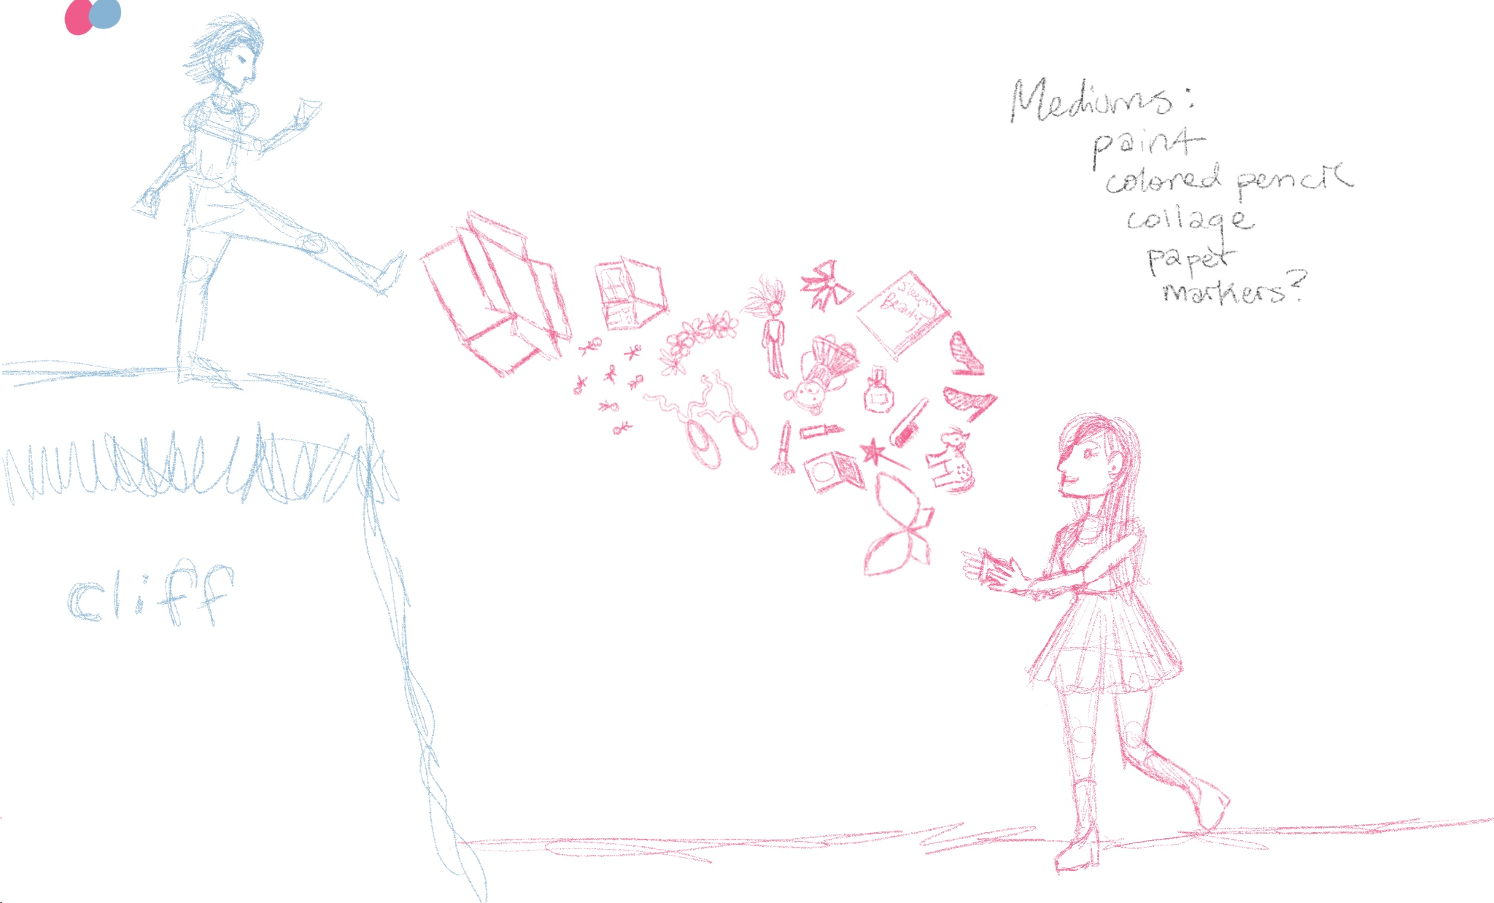
Initial Idea
Younger me, 12 years old, kicking away a box full of pink girly objects, “I don’t want these anymore”
My current 21 year old self catching the items, because I actually do want them and they make me happy
Notes:
Younger me, 12 years old, kicking away a box full of pink girly objects, “I don’t want these anymore”
My current 21 year old self catching the items, because I actually do want them and they make me happy

Slide 5
Roadblocks
I had pictures from magazines I wanted to use
But I could not find the really specific ones I was looking for
However, I still wanted to include the magazines photos
I was worried that the photos of various products would look strange next to my drawings
Eventually I decided to include both!
Notes:
I wasn’t sure if I wanted to use the photos of objects I found in my collage magazines, because some of them are perfect (perfume bottle, pink sweater, etc.)
However, I want this piece to be personalized to me, and some things that were a part of my adolescence do not appear in magazines
It was important for me to have the items that are specific to my adolescent journey, but I was worried that the photos of various products would look strange next to my drawings
Eventually I decided to include both, because I really wanted to use both, and I think it turned out well.

Slide 7
Bibliography
Brooke, Abigail. (2019, April 30). Women’s interests aren’t taken seriously, and here’s why: a personal perspective on how society trivializes women’s interests. The Waltonian.
https://waltonian.eastern.edu/opinions/womens-interests-arent-taken-seriously-and-heres-why-a-personal-perspective-on-how-society-trivialzes-womens-interests/
BSN Voices. (2020, March 12). Why do we devalue femininity? The British School in the Netherlands’ Blog. https://voices.britishschool.nl/2020/03/12/why-do-we-devalue-femininity/
Jones, Ingrid. (2020). The internalized misogyny in hating girly girls. Women’s Republic. https://www.womensrepublic.net/the-internalized-misogyny-in-hating-girly-girls/
Marriott-Fabre, E. (2022, May 25). Internalized misogyny limits female self-expression, success. The Standard. https://standard.asl.org/20284/features/internalized-misogyny-limits-female-self-expression-success/
YouthSpeak. (2021, April 1). Internalized Misogyny and Women’s Mental Health. YouthSpeak. https://youthspeak.ca/2021/04/has-internalized-misogyny-and-feminism-affected-your-mental-health/

